Slide 1
Automatic Recognition Of Power Quality Disturbances
BY:
SAKET SAURAV LAL
TANMAY KUMAR NANDA
ASHISH KUMAR SINGH
SUSHRUT PATNAIK
PRABHASH BEHERA
GUIDED BY:
DEBADATTA AMARESH GADANAYAK

Slide 2
What is Power Quality?
The concept of powering and grounding of sensitive (electronic) equipment in a manner that is suitable to the operation of that equipment and compatible with the premise wiring system and other connected equipment. Any Deviation of the voltage or current waveforms from pure sinusoidal is a power quality problem.

Slide 3
Types of power quality disturbances
Voltage sag
Voltage swell
Voltage interruption
Voltage Noise

Slide 4
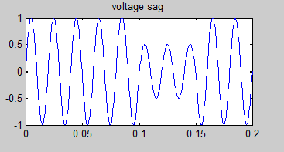
Voltage Sag
Also called “dip”
Reduction in RMS voltage for short duration
Defined by IEEE standard 1159 as duration of 0.5 cycles to 1 minute
Can be caused by varying loads, short circuits, motor circuit, single line-ground fault

Slide 5
Effects of voltage sag
Consumer equipment can be interrupted
Furnace relays, computers, etc .
Long term voltage sags can interrupt factory processes.

Slide 6
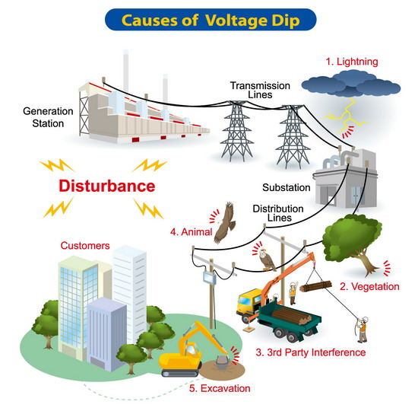

Slide 7
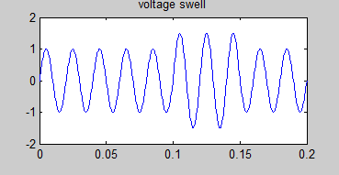
Voltage Swell
Defined by IEEE 1159 as the increase in the RMS voltage level to 110%-180% of the nominal at the power frequency for duration of 0.5 cycles to 1min. It is basically the opposite of sag.

Slide 8
Its causes and effects
Are generally associated with system fault condtions. In case of SLG fault the result is a temporary voltage rise on the unfaulted phases which last for duration of fault.
Caused by de-energization of very large loads and energization of a large capacitor bank.
Effects : May cause breakdown of components on the power supplies of the equipment(overheating)
can cause control problems and hardware failures.

Slide 9
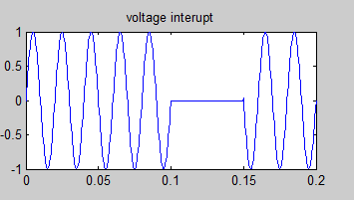
Voltage Interruption
Is a complete power loss which can last a second or several hours.
Equipment failures or damage to power lines from lightning, strong winds or car accidents can cause interruptions.
These outages can effect the power to one Home, one street or entire town.
Momentary interruption (0.5 to 3secs)
Sustained interruption(>1min)
Temporary interruption
(3sec -1min)

Slide 10
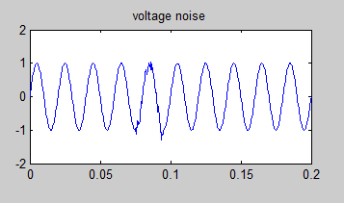
Voltage Noise
Unwanted electrical signals which produce undesirable noise in the circuit of the control system in which they occur.

Slide 11
Design Flow
Signal Generation
Parameters- Entropy, Mean, Variance, Skewness etc.
Neural Networks
Verification

Slide 12
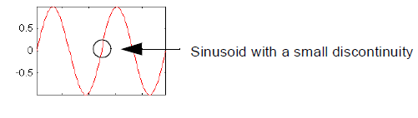
What Can Wavelet Analysis Do?
One major advantage afforded by wavelets is the ability to perform local analysis — that is, to analyse a localized area of a larger signal.
Consider a sinusoidal signal with a small discontinuity — one so tiny as to be barely visible. Such a signal easily could be generated in the real world, perhaps by a power fluctuation

Slide 13
What is Wavelet Analysis?
Now that we know some situations when wavelet analysis is useful, it is worthwhile asking the questions “What is wavelet analysis?” and even more fundamentally, “What is a wavelet?”
A wavelet is a waveform of effectively limited duration that has an average value of zero.
Fourier analysis consists of breaking up a signal into sine waves of various frequencies. Similarly, wavelet analysis is the breaking up of a signal into shifted and scaled versions of the original (or mother) wavelet.

Slide 14
Properties of Mother Wavelet
The mother wavelet must have the following properties.
it must be oscillatory,
it must quickly decay to zero
it must have a zero average
it must be band pass
it must be integrate to zero

Slide 15
Discrete wavelet transformation
The DWT decomposes the signal in the time domain into several scales at different levels. The wavelet transformation coefficients at the several scales reveal the time localizing information about the variation of the signal from high to low frequency bands. Therefore non periodic and high frequency signals arising from transient disturbances can be easily detected and localized in the time domain. Unlike the Fourier transform which gives a global representation of a signal the wavelet transform on other hand provides a local representation in both time and frequency of a signal, it is more suitable for time frequency analysis on high resolution.

Slide 16
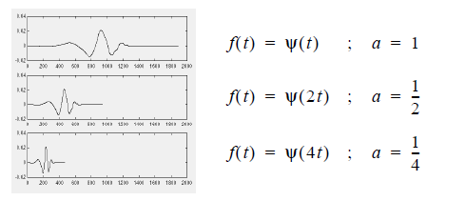
Scaling
Scaling a wavelet simply means stretching (or compressing) it. To go beyond colloquial descriptions such as “stretching,” we introduce the scale factor, often denoted by the letter ‘a’. If we’re talking about wavelets, for example, the effect of the scale factor is very easy to see:

Slide 17
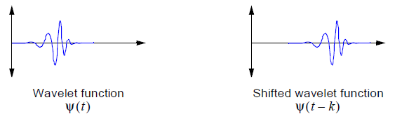
Shifting
Shifting a wavelet simply means delaying (or hastening) its onset. Mathematically, delaying a function f(t) by k is represented by f(t – k) :

Slide 18
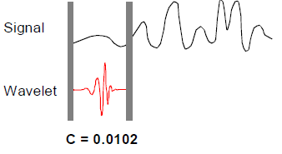
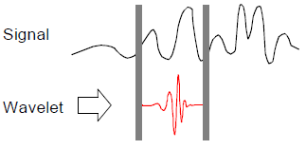
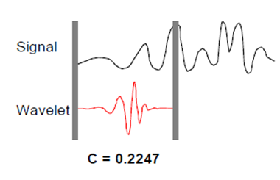
How scaling and shifting are done?

Slide 19
Scale and Frequency
The more stretched the wavelet, the longer the portion of the signal with which it is being compared, and thus the coarser the signal features being measured by the wavelet coefficients.
Thus, there is a correspondence between wavelet scales and frequency as revealed by wavelet analysis:
•Low scale a => Compressed wavelet => Rapidly changing details => High frequency w
•High scale a => Stretched wavelet => Slowly changing, coarse features => Low frequency w

Slide 20
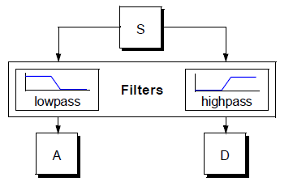
One-Stage Filtering: Approximations and Details
For many signals, the low-frequency content is the most important part. It is what gives the signal its identity. The high-frequency content, on the other hand, imparts flavour or nuance. The approximations are the high-scale, low-frequency components of the signal. The details are the low-scale, high-frequency components.

Slide 21
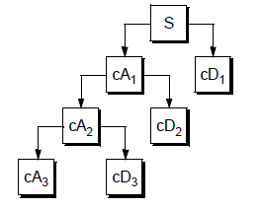
Multiple-Level Decomposition
The decomposition process can be iterated, with successive approximations being decomposed in turn, so that one signal is broken down into many lower-resolution components. This is called the wavelet decomposition tree.

Slide 22
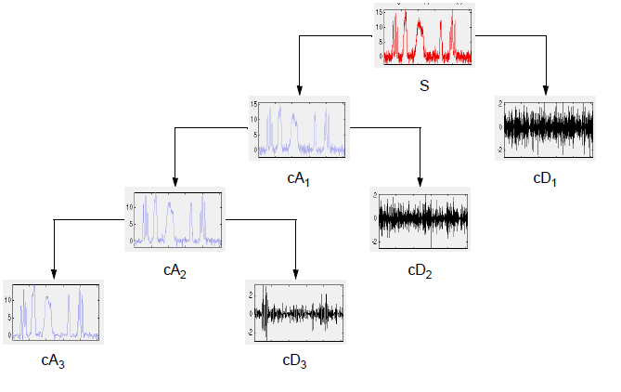
Wavelet Decomposition Tree
Looking at a signal’s wavelet decomposition tree can yield valuable information.

Slide 23
Artificial Neural Networks
An Artificial Neural Network (ANN) is an information processing paradigm that is inspired by the way biological nervous systems, such as the brain, process information. The key element of this paradigm is the novel structure of the information processing system. It is composed of a large number of highly interconnected processing elements (neurons) working in unison to solve specific problems. ANNs, like people, learn by example. An ANN is configured for a specific application, such as pattern recognition or data classification, through a learning process. Learning in biological systems involves adjustments to the synaptic connections that exist between the neurons. This is true of ANNs as well.

Slide 24
Learning
Supervised Learning which incorporates an external teacher, so that each output unit is told what its desired response to input signals ought to be. During the learning process global information may be required. Paradigms of supervised learning include error-correction learning, reinforcement learning and stochastic learning.
Unsupervised Learning uses no external teacher and is based upon only local information. It is also referred to as self-organization, in the sense that it self-organizes data presented to the network and detects their emergent collective properties. Paradigms of unsupervised learning are Hebbian learning and competitive learning.

Slide 25
Network architectures
Three different classes of network architectures
single-layer feed-forward neural network
multi-layer feed-forward : contains hidden layers but no loops.
Recurrent : No hidden layers but can have self feedback loops.

Slide 26
Single Layer Feed-forward
Input layer
of
source nodes
Output layer
of
neurons

Slide 27
Multi layer feed-forward
3-4-2 Network
Input
layer
Output
layer
Hidden Layer

Slide 28
Recurrent network
Recurrent Network with hidden neuron(s): unit delay operator z⁻¹ implies dynamic system
z⁻¹
input
hidden
output
z⁻¹
z⁻¹

Slide 29
The Neuron
Bias
b
x₁
w₁
Activation
function
Local
Field
v
Output
y
Input
signal
x₂
w₂
Summing
function
x_{m}
w_{m}
Synaptic
weights

Slide 30
Pattern Recognition
An important application of neural networks is pattern recognition. Pattern recognition can be implemented by using a feed-forward neural network that has been trained accordingly. During training, the network is trained to associate outputs with input patterns. When the network is used, it identifies the input pattern and tries to give the associated output pattern. The power of neural networks comes to life when a pattern that has no output associated with it, is given as an input. In this case, the network gives the output that corresponds to a taught input pattern that is least different from the given pattern.

Slide 31
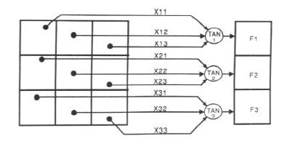
Pattern Recognition Example

Slide 32

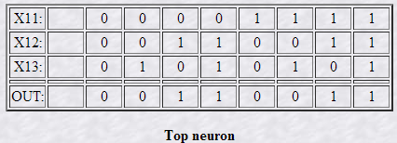
Pattern Recognition Contd.
The network of figure is trained to recognise the patterns T and H. The associated patterns are all black and all white respectively as shown below.
If we represent black squares with 0 and white squares with 1 then the truth tables for the 3 neurones after generalisation are;

Slide 33
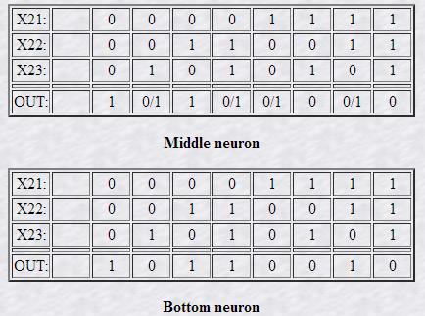
Pattern Recognition Contd.

Slide 34
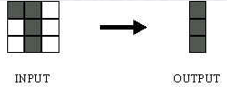
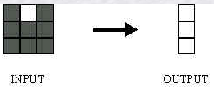
Pattern Recognition Contd.
From the tables it can be seen the following associations can be extracted:
In this case, it is obvious that the output should be all blacks since the input pattern is almost the same as the 'T' pattern.
Here also, it is obvious that the output should be all whites since the input pattern is almost the same as the 'H' pattern.

Slide 35
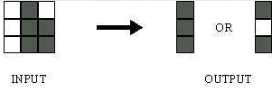
Pattern Recognition Contd.
Here, the top row is 2 errors away from the a T and 3 from an H. So the top output is black. The middle row is 1 error away from both T and H so the output is random. The bottom row is 1 error away from T and 2 away from H. Therefore the output is black. The total output of the network is still in favour of the T shape.

Slide 36
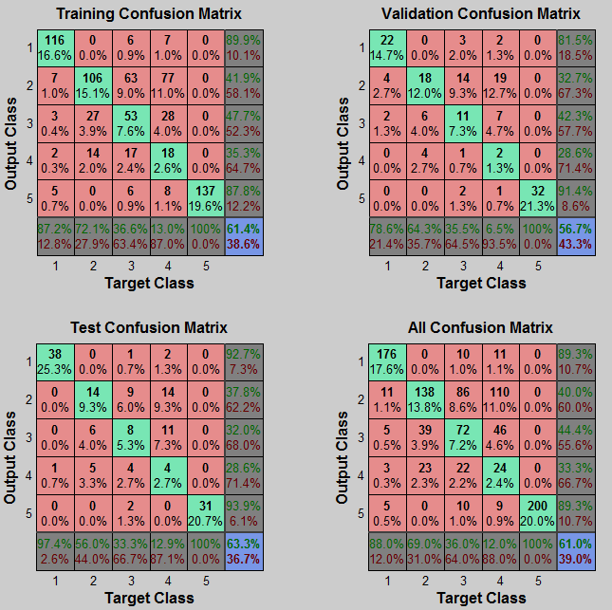
Confusion Matrix

Slide 37
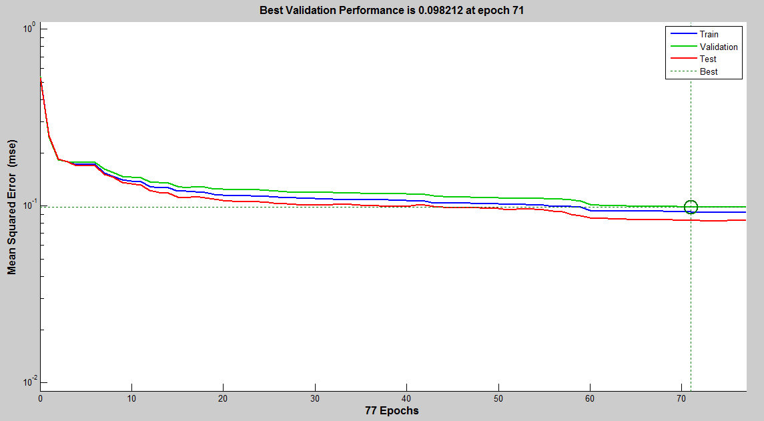
Performance-MSE

Slide 38
CONCLUSION
This project develops state of art signal classification algorithms for classifying different types of power quality disturbances based on wavelet analysis using MATLAB.
200 random samples of voltage sag, swell, interrupt and noise were generated and 3 level decomposition of the signals were done using DWT and various statistical parameters (mean, variance, skewness etc) were obtained for each signal.
These parameters were arranged into a matrix and fed into the neural network pattern recognition tool and the performance of the algorithm was observed.

Slide 39
REFERENCES
“Automatic Recognition of Power Quality Disturbances” by Min wang, M Sc.,University of Washington, 2001.
Power quality by John Stones and Alan Collinson, POWER ENGINEERING JOURNAL, APRIL 2001

